Slide 1

Sustainability at Nestor Hotel

Slide 2

Welcome to our eco-conscious hotel!
We are thrilled to introduce you to our sustainability programs, an initiative that reflects our commitment to responsible tourism.

Slide 3
Our commitments
Quality: We deliver consistent, honest, and continually improving service that exceeds guest expectations.
Food Safety: We operate a strict HACCP system to safeguard food hygiene, allergens, and traceability at all times.
Health & Safety: We prevent harm by identifying risks, maintaining safe facilities, and practicing emergency readiness.
Environmental Management: We manage our impacts through measurable goals to reduce energy, water, waste, and pollution.
Climate: We cut emissions by using efficient technologies, optimizing operations, and tracking our carbon footprint.
Biodiversity & Land: We protect local ecosystems by avoiding wildlife harm and supporting nature-positive actions.
Human Resources Development: We provide fair work, equal opportunity, and ongoing training for career growth.

Slide 4
Our commitments
Human Rights: We respect international human rights, prohibit exploitation, and protect personal data.
Child Protection: We enforce zero tolerance for child abuse, train staff to act, and report concerns immediately.
Community & Culture: We create local value by hiring, buying, and partnering within our community while honoring culture and heritage.
Guest Engagement: We inform and empower guests to participate in our sustainability actions during their stay.
Compliance & Governance: We comply with laws, ISO 14001, Travelife, and Green Key requirements, and uphold integrity and transparency.
Continuous Improvement: We set objectives, measure progress, and review policies annually to drive better outcomes.

Slide 5
Your support
Please support and participate in our Travelife and Green Key sustainability commitments and goals during your stay.

Slide 6


The Green Key, created in 1994 in Denmark, is a leading voluntary standard of environmental responsibility and sustainable operation excellence within the hospitality and tourism industry.
Travelife: an independent, internationally recognized sustainability certification for hotels, with audited criteria covering energy, water, waste, biodiversity, fair labor and human rights, community support, and responsible sourcing—helping guests choose responsible stays and driving continuous improvement.

Slide 7
Energy saving
Do not leave the light on for any reason.
Do not leave the mini cooler door open and do not tamper with the thermostat.
Do not your key card in the key fobs while not in the room.
Beyond energy savings the correct use of air conditioning units’ thermostats contributes to your own comfort. The ideal temperatures are 23-25°C for the summer period.

Slide 8
Water saving
Water in Cyprus is extremely precious due to the little rainfall. Please use it sensibly, having in mind that about one third of the planet’s population does not have access to clean and safe water. Therefore:
Do not fill the bath with water if there is no reason.
Do not leave the taps running.
Report any fault or leak immediately.

Slide 9
Linen change
Linen is changed twice a week
Towels are changed daily
We invite you to join with us to save water by using your towels more than once.

Slide 10
Food waste reduction
As you are aware, reducing food waste is very beneficial for the environment:
Order only what you can consume. For example, start with smaller portions and order more if needed. You can always request additional items later.
Help up to effectively maintain our individual portions program, offering smaller portion sizes for certain buffet dishes. In this way you can enjoy a variety of dishes without excess leftovers.
Provide clear instructions on proper storage and reheating to maintain food quality.

Slide 11
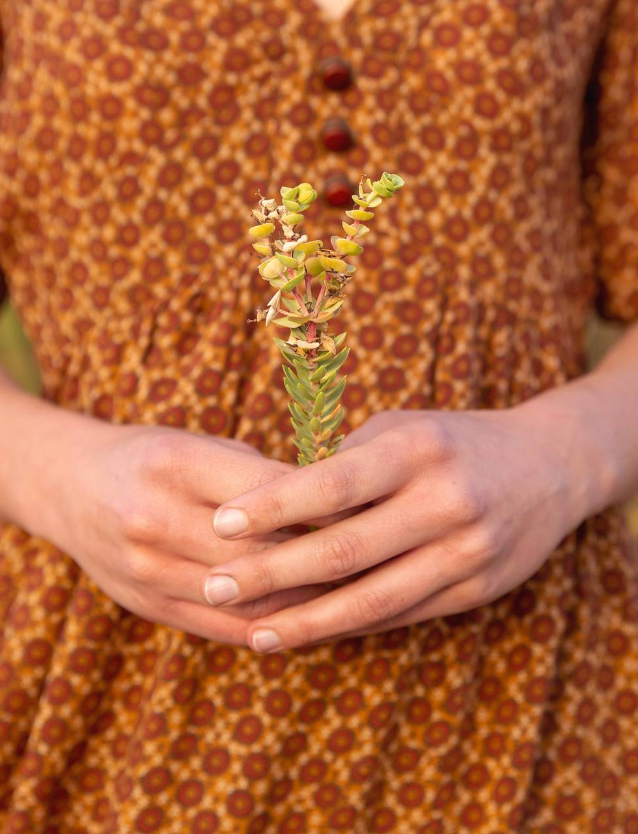
Support the local community
Explore the surroundings. Use local transportation, rent a bike, or walk instead of calling a taxi.
Be a local. Use the opportunity to learn about local culture, try local food and learn some words in the local language.

Slide 12
Respect Cyprus
Leave no trace. Use bins for rubbish and recycling; take litter with you if bins are full.
Protect nature. Don’t cut flowers, damage trees, or disturb wildlife or habitats. Avoid activities that harm animals.
Stay on marked paths. This safeguards fragile archaeological sites, plants, and animals.
No fires in the wild. Cyprus is very dry in summer, and fires start easily. Barbecues are allowed only in designated picnic areas.
Respect the heritage. Do not touch, step on, collect, or remove archaeological relics or artifacts.
Obey signs and barriers. Fenced or restricted areas protect the site—view from outside.
Follow the law. Buying, selling, exporting, or handling antiquities without a Government of Cyprus permit is illegal and severely punished.
Honor sacred places. In churches, monasteries, and mosques: keep voices low, observe visiting hours, and dress modestly (some monasteries provide cover-ups).
Think safety. Watch for uneven terrain, drop-offs, and loose rocks; wear suitable footwear and carry water.
Cyprus holds over 10,000 years of history, culture, and natural beauty. During your stay, help us protect what makes the island special.
Thank you for helping us keep Cyprus’ heritage and nature thriving—for today’s visitors and tomorrow’s

Slide 13
Embrace Sustainable Commuting for a Greener Tomorrow!
Every small effort adds up, and your decision to use public transport, bicycles, or carpooling significantly reduces your carbon footprint.
Public transport and carpooling are cost-effective alternatives to solo commuting.
Save money on fuel, parking, and maintenance by sharing rides or utilizing public
transportation options.
Consider investing in a bicycle for a one-time cost that pays off in health benefits and long-term savings. It promotes an active lifestyle, reduces stress, and boosts overall well being.
In line with these principles, we encourage everyone to explore the various transportation options available, and we are here to support you in making the transition.

Slide 14
thank you

