Slide 1
Sustainability Report
For the year 2023

Slide 2
Quality, Food Safety, Health & Safety Policy – IMS Policy Last Modified: 9th June 2023 The management team at Nestor Hotel has established this “Quality, Food Safety, Health & Safety Policy” aimed at improving the quality of services of the hotel and the full compliance with the current standards of food safety and hygiene as well as occupational safety and health. This policy provides a reference framework for the development and revision of the company’s objectives, commitments and mission statement. The management team is fully committed to personally applying the rules laid down in the hotel’s operations manual, as well as all relevant procedures and instructions, and verifying their application by all members of staff through annual system audits and management reviews to ensure the requirements under this policy are systematically implemented and continually improved. For this purpose, the hotel is committed to focus on achieving the following high-level objectives: To ensure compliance with current laws affecting our activities in terms of customer service, food safety and occupational safety and health; To ensure that food safety standards, health & safety standards are agreed on with our stakeholders; To create and constantly defend a work culture that allows us to anticipate the needs of our customers, prioritising customer satisfaction; To guarantee the hygiene and safety of the food that we produce; To provide a safe and healthy work from any incidents, accidents and occupational diseases. To engage all staff members in our continuous improvement strategy within the scope of our Quality, Food Safety, Occupational Health & Safety Management System. This present policy is applicable to all parts of our business and business activities, is available to all interested parties and is reviewed regularly as to its suitability.

Slide 3
Total Energy Consumption
An overall reduction of 15% was achieved in the total energy consumption between 2022 and 2023 through a series of energy efficiency merasures and staff training. The aim for 2024 is for the total consumption to be decreased to 14 kwh per guest night.

Slide 4
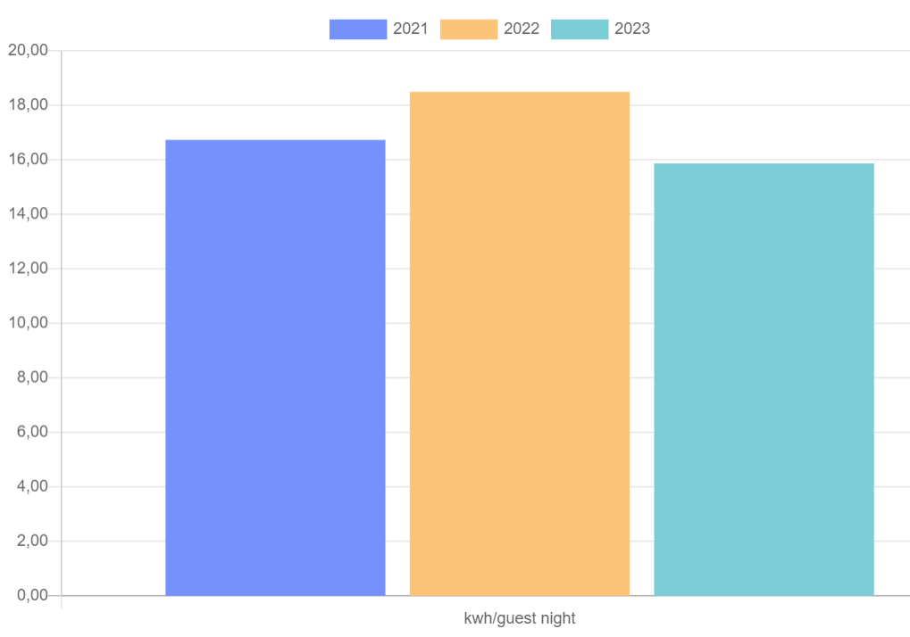
Total Energy Consumption

Slide 5
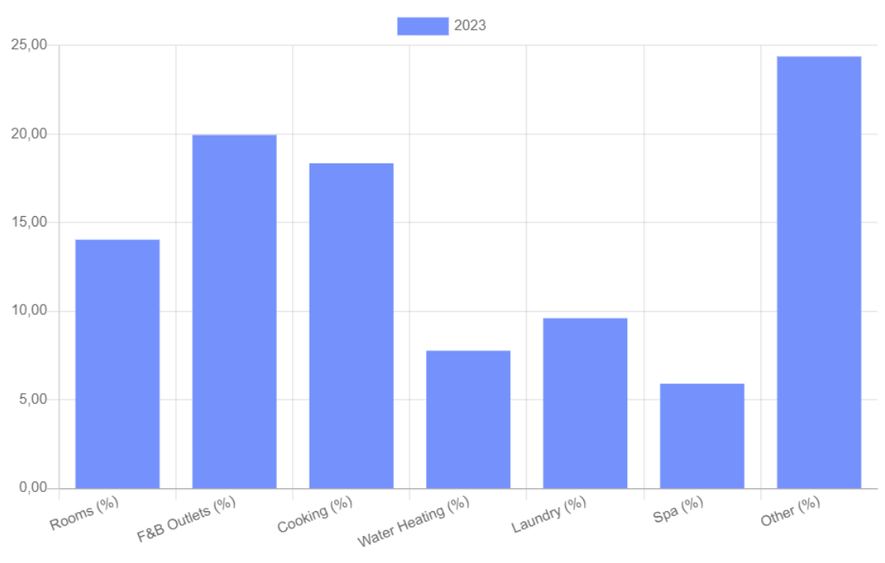
Energy Analysis for 2023

Slide 6
Electricity Consumptions – Actions & Mechanisms for Improvement
GUEST INVOLVEMENT
TRAVELIFE
& GREEN KEY
PREVENTIVE MAINTENANCE
ISO 14001:2015
CONTINUOUS IMPROVEMENT
EMPLOYEE
TRAINING
PURCHASE OF NEW ENERGY EFFICIENT EQUIPMENT
CONTINUOUS MONITORING

Slide 7
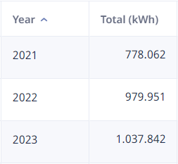
Electricity Consumption
2022
14.09
kwh/gn
13.33 kwh/gn
2023
11.72
kwh/gn
Target 2024
9.09
kwh/gn
2021
Having assessed our energy consumption and following certain practices, as well as training for both our guests and staff and continuous monitoring, a decrease of 17% was noted between 2022 and 2023. The goal is to further reduce our electricity consumption by 25% through the purchase and installation of energy-efficient and energy-saving equipment/ tools, the continuous training of personnel and the ongoing efforts towards sensitizing staff customers to save energy.

Slide 8
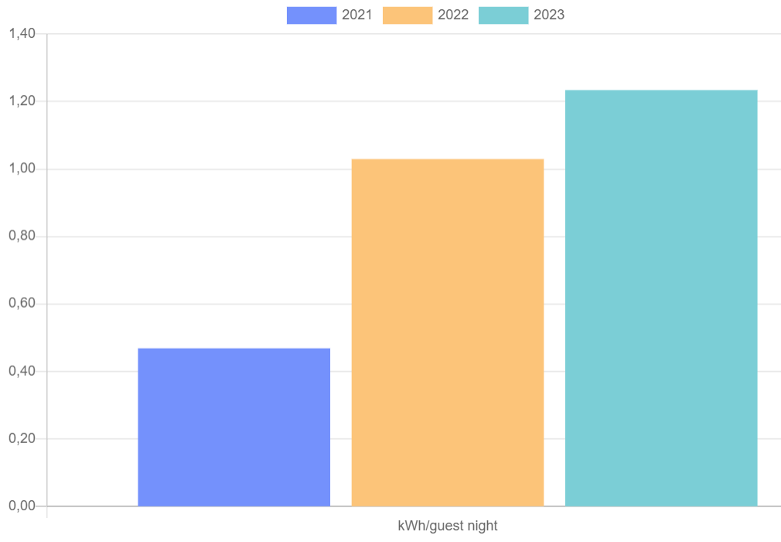
Diesel Consumption
There was an increase in the consumption due to the colder weather in the months March/April/May/ October which resulted in a higher consumption of diesel to heat up the water. The objective for 2024 is to reduce the consumption of diesel by 10% to 0.1lt/guest night.

Slide 9
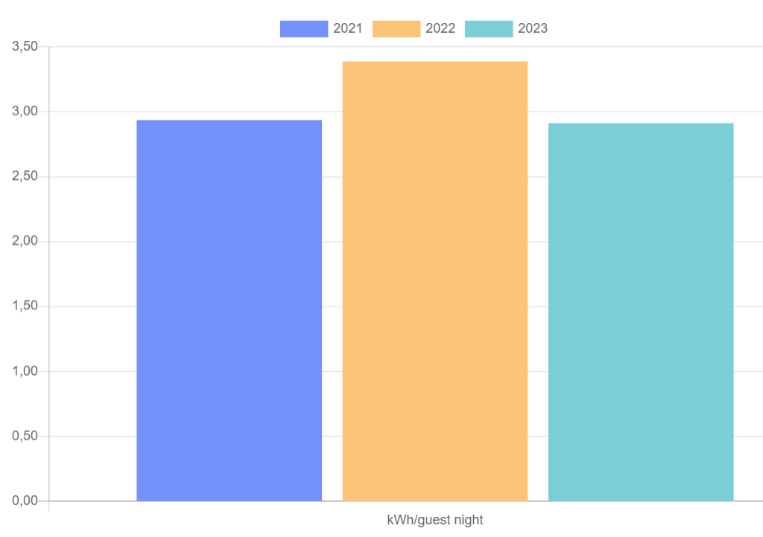
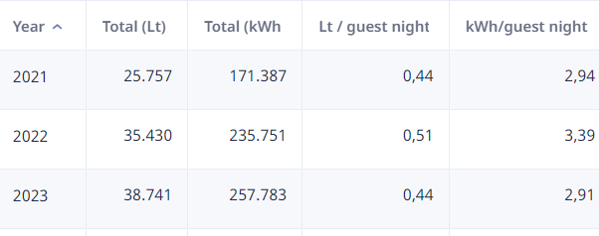
LPG Consumption
A decrease of 15% is noted as a result of further training, adoption of good practices, and a significant increase in the number of the guest night. For 2024 the goal is to reduce the LPG consumption to 0.41 lt / guest night or 2.64 kwh / guest night. This will be mainly achieved through the rational use of LPG in the kitchen operation and the preventive maintenance of LPG equipment / machinery.

Slide 10
CO₂ Consumption
2022:
0.24 Kg
/guest night
2023:
0.20 Kg
/guest night
2024 Target: <0.19 kg
/guest night
The hotel uses the Sustainable Hospitality Alliance method to calculate its emissions.

Slide 11
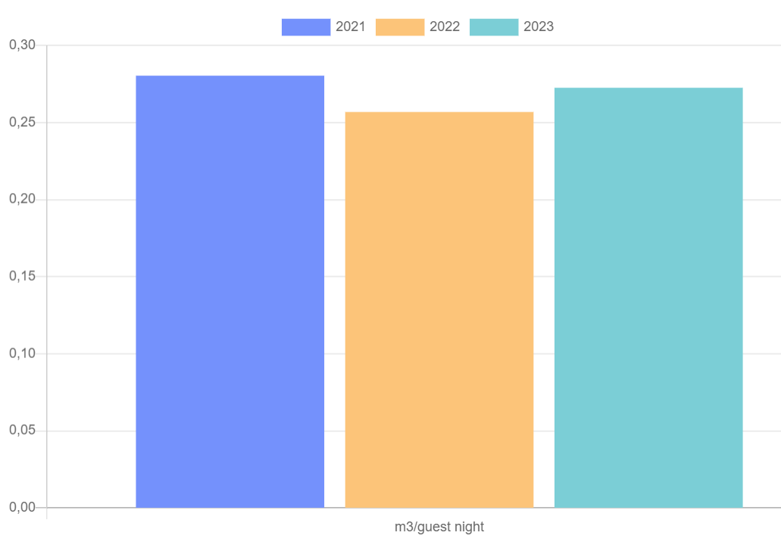
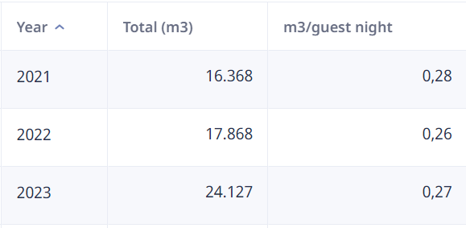
Water Consumption
There was a minor increase in the water consumption between 2022 and 2023. For 2024 the goal is to reduce the water consumption to 0.2 lt / guest night. This will be mainly achieved through the installation of water saving tools/ equipment in the hotel’s bathrooms and guestrooms and the ongoing taining and education of our staff and guests in the matter.

Slide 12
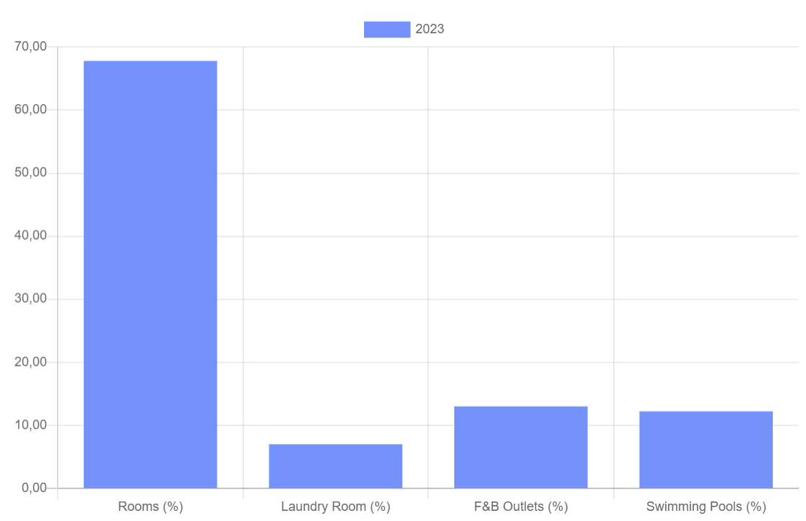
Water Analysis for 2023

Slide 13
Water Management Controls
SHOWERS WATER FLOW 3.15 - 5 LTR/MIN
TRAINING
WATER FLOW REDUCERS
TOILETS 6 LTR PER FLUSH
WATER FLOW TAPS: 2.2 - 3.15 LTR/MIN
GARDENS WATERING POLICIES
GUESTS' AWARENESS
STAFF TRAINING

Slide 14
Chemical’s Consumption
2022
0.16
lt/gn
2021
0.14
lt/gn
2023
0.192
lt/gn
Target 2024
0.185
lt/gn
Keeping chemicals consumption low, only trained and authorized users, searching for eco friendly chemicals and using disinfectants only when and where necessary…

Slide 15
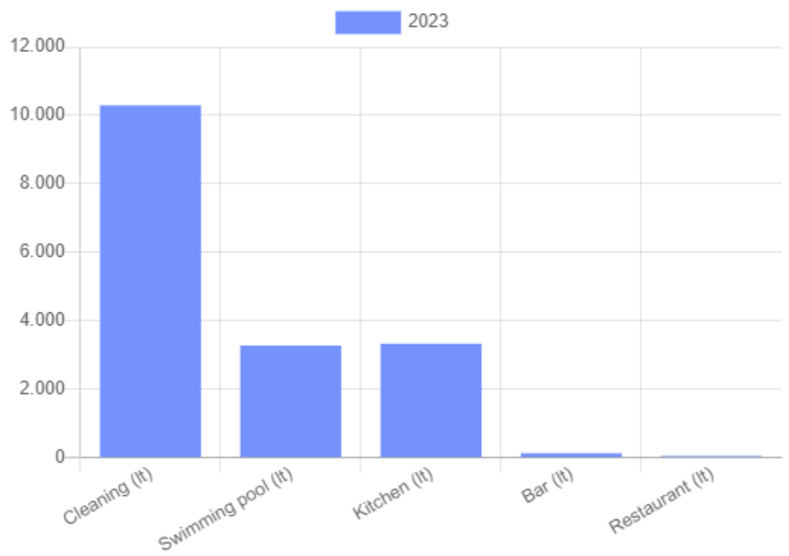
Chemical’s Consumption 2023

Slide 16
Waste Management Performance
Recyclables 0,10 kg gn
Glass
0,07 kg gn
Oil 0,016 lt gn
Organic waste 0,15 kg gn
2022
Recyclables 0,22 kg gn
Glass
0,185 kg gn
Oil 0,018 lt gn
Organic waste 0,18 kg gn
2023
Recyclables 0,25 kg gn
Glass
0,16 kg gn
Oil 0,015 lt gn
Organic waste 0,16 kg gn
2024 TARGETS

Slide 17
Actions to tackle and reduce waste
Implemented Actions
Key Aims / Actions
Elimination of single use plastic
Replacement of plastic bags with paper bags
Installation of soap and shampoo dispensers in guest rooms
Installation of water fridges in public areas
Cooperation with companies that take back the glass bottles / packaging they supply
Use of larger containers for chemicals and other consumables to reduce the required amount of packaging to be disposed/ recycled
Emphasis on reduce and reuse
Recycling of paper, cartons, PMD, cooking oil, wee, toners and more
Recycling bins in all guest and staff areas
Awareness campaigns to guests & employees
Training of supervisory team
Elimination of plastic straws and reduction of plastic use.
Observe World environment day

Slide 18
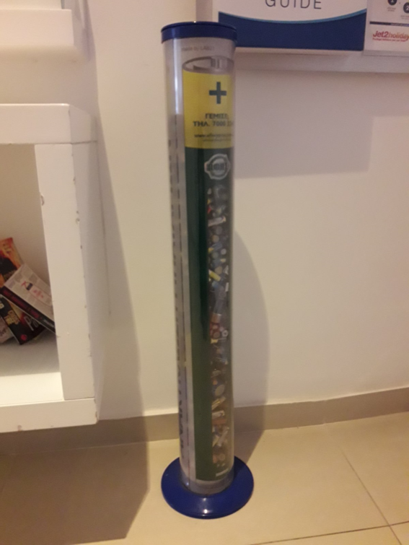
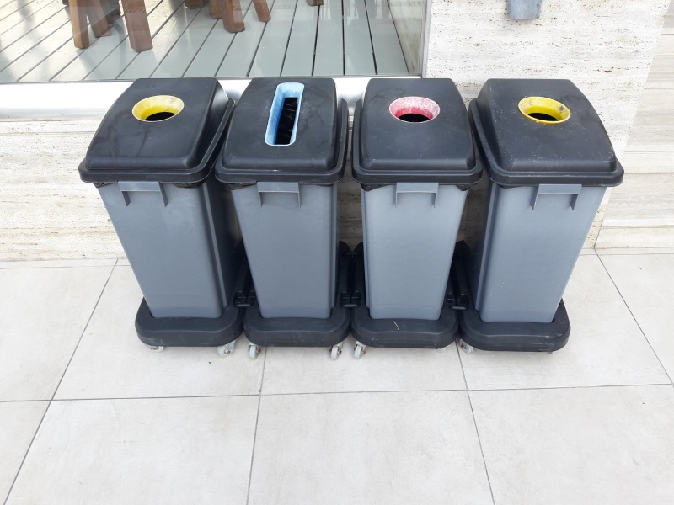
Recycling @ Guest areas
Samples of the hotel’s recycling bins for guests’ use for paper, plastic, organic waste and batteries

Slide 19
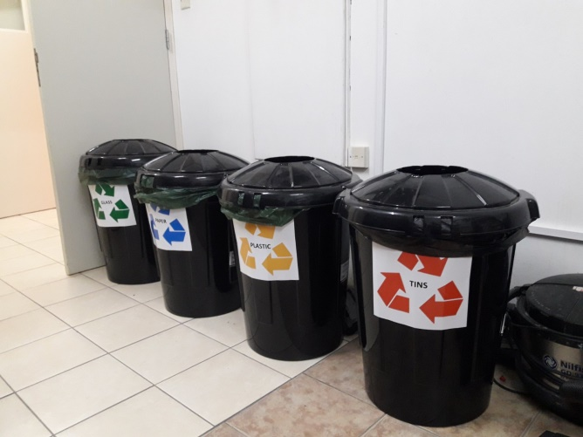
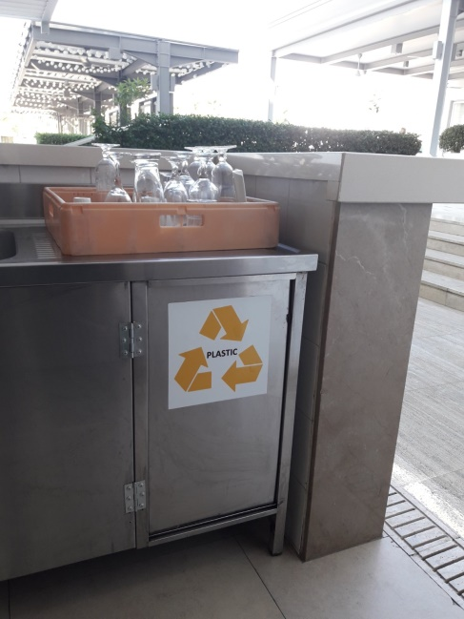
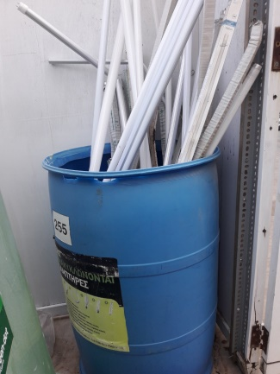
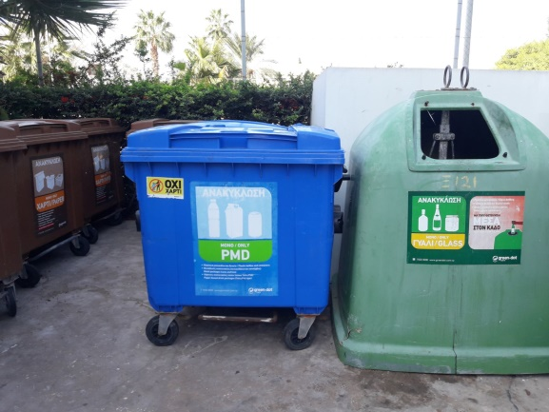
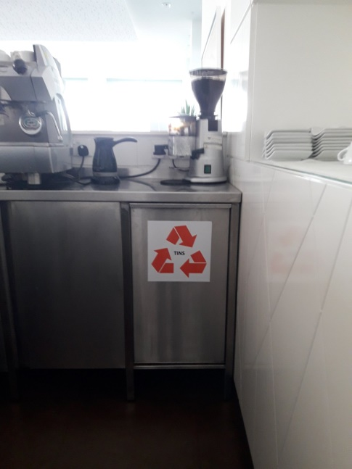
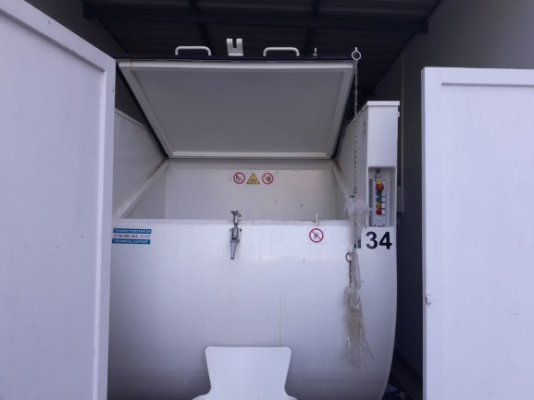
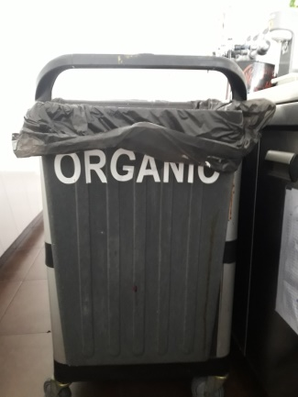
Recycling @ Employee areas
Recycling bins and areas for staff use for light bulbs, paper, plastic, organic waste, cooking oil and batteries

Slide 20
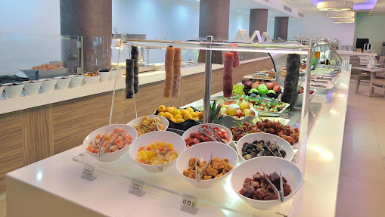
Sustainable Procurement Practices
Promotion of local products
Buffet Displaying of traditional local products
Local suppliers >80%
Responsible / Certified suppliers
Sustainability criteria for tenders

Slide 21
Sustainability Actions Supporting local businesses, culture, cuisine and food sourcing
Local Food & Beverage sourcing >80% in 2023
Promoting the Cypriot cuisine through including Cypriot tastes and products in our daily buffets.
Promoting excursions to several local attractions on the mountains of Cyprus.
Promoting local products through our Cyprus Evening Buffet and through our Breakfast Buffet
Promoting Cyprus culture and customs through Cyprus folklore dancing shows
Promoting places of interest in Cyprus through our web page

Slide 22
Community Integration
Children’s Rights Awareness Campaign

Slide 23
Community Integration
Our Children’s Protection Policy

Slide 24
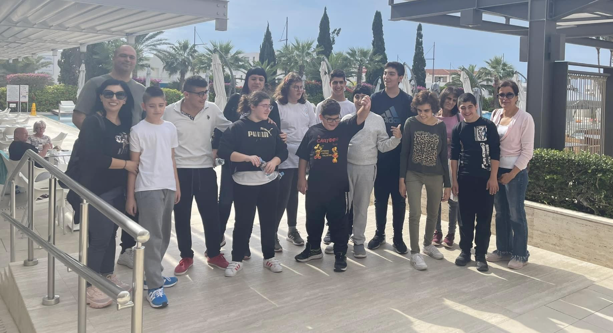
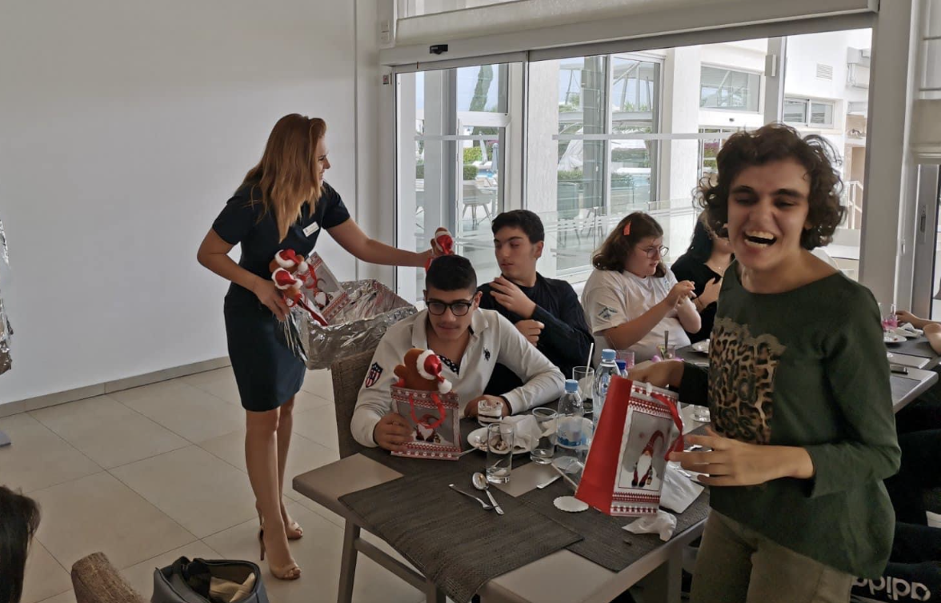
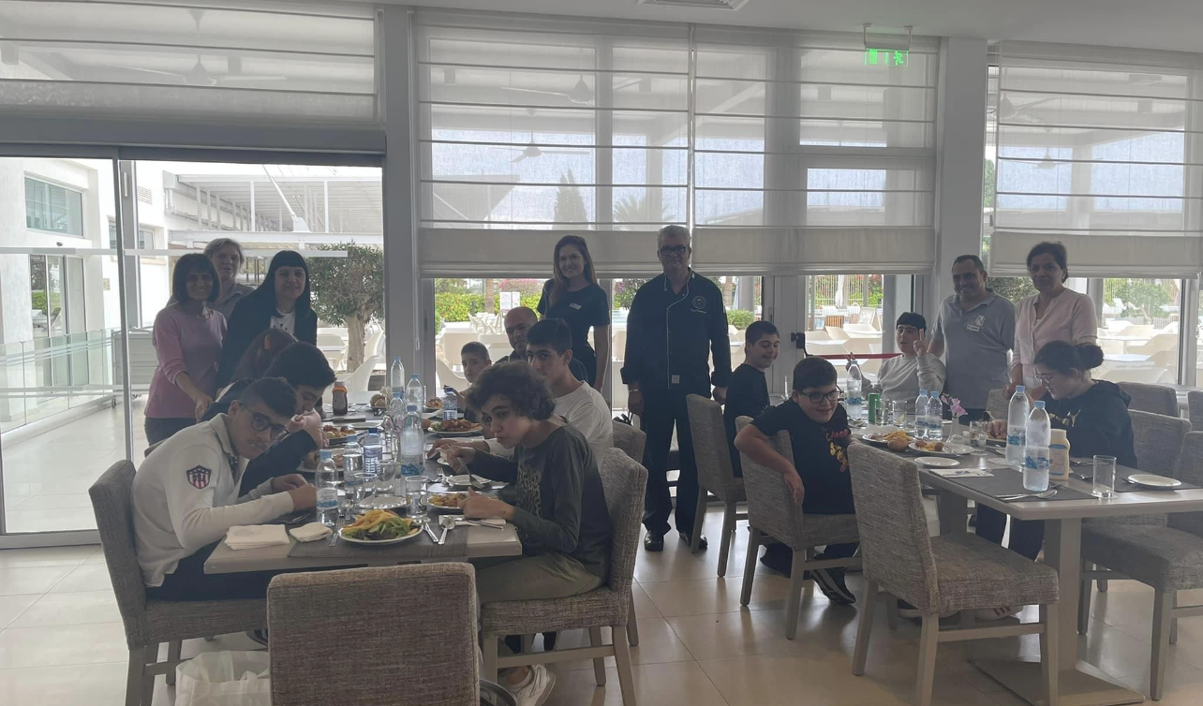
Local community engagement – Agios Varnavas school

Slide 25
Fair Employment
Personnel Origin
45% Local
35% Non-Local - EU
20% Non-Local -Third Countries
Gender
56% Female
44% Male
Employment Policy
Recognizing the vital importance of supporting our local community over the long term, our company policy prioritizes hiring individuals from the local population. However, we are equally dedicated to nurturing, developing, and offering opportunities to all people. Ensuring their well-being, health, and safety is paramount to us. At Nestor hotel, every employee is treated with fairness and respect, regardless of their sexuality, gender, age, ethnicity, religion, or disability. We provide comprehensive training opportunities for all staff to proficiently execute their daily tasks according to established standards. Evaluation and advancement opportunities are solely based on individual merit, ensuring equal opportunities for all.

Slide 26
Guest Satisfaction Questionnaires
INTERNAL CSQs
2022
85.80%
2023 target 85.8%
2024 target
90%
Through a sample of ALL internal guest questionnaires during 2023!

Slide 27
“We do not inherit the Earth from our ancestors; we borrow it from our children.”
– Native American Proverb
Green & Warm Regards,
The team of Nestor Hotel

